Slide 1

Distributions beyond the normal
or where black swans nestle

Slide 2
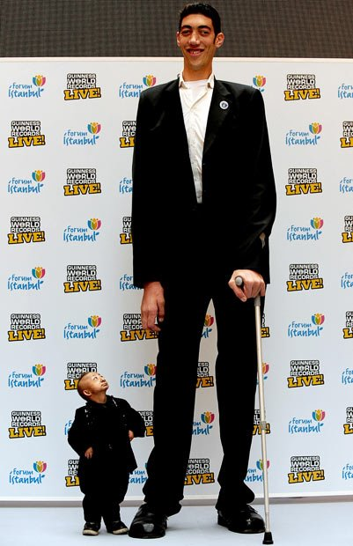
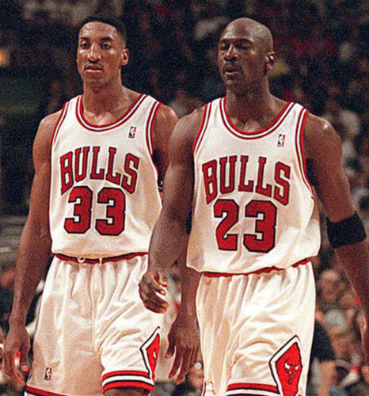

distribution of height
$$\sum_{A, B}{Height}=400 cm$$
?
200 + 200 350 + 50

Slide 3
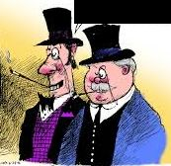


distribution of wealth
$$\sum_{A, B}{Wealth}=\$100M$$
?
50M + 50M 100M + 0

Slide 4
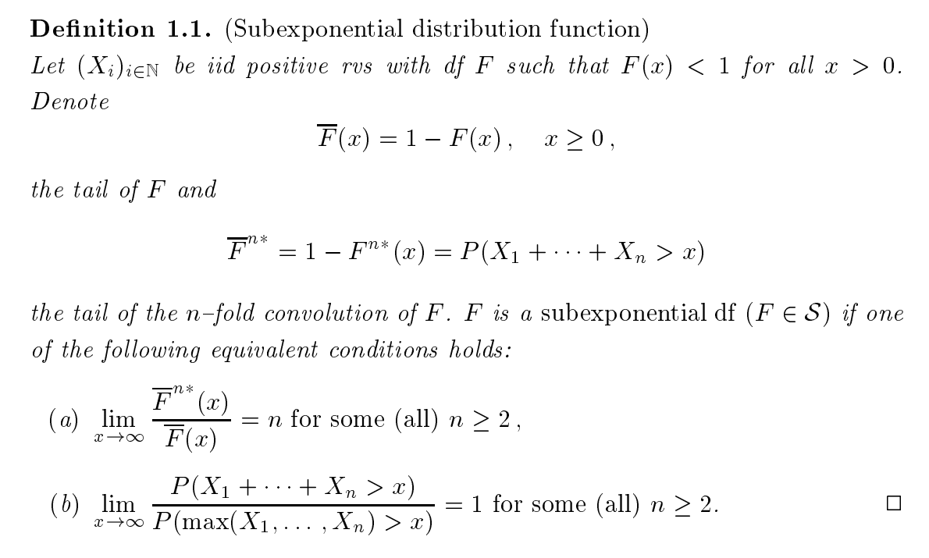
Mathematical definition

Slide 5
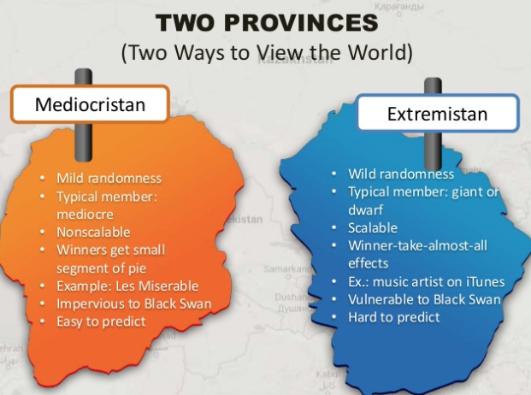

Slide 6
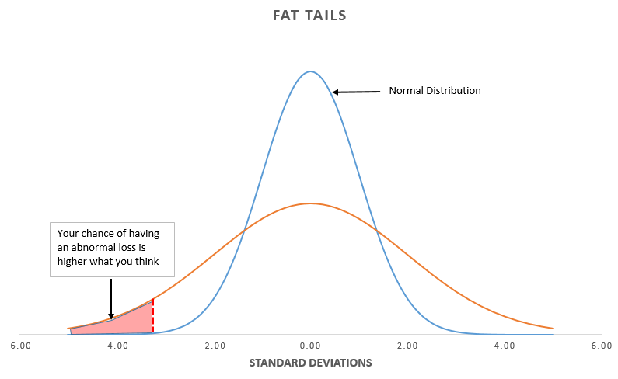
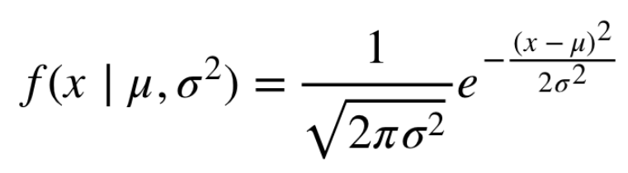
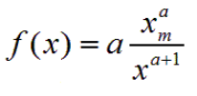
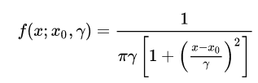
python simulation:
TYPICAL PROBABILITY DISTRIBUTIONS
MEDIOCRISTAN: Normal
EXTREMISTAN:
Pareto / Cauchy
https://notebooks.azure.com/home/projects

Slide 7
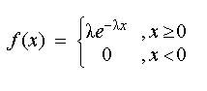
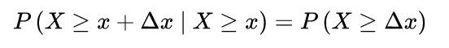

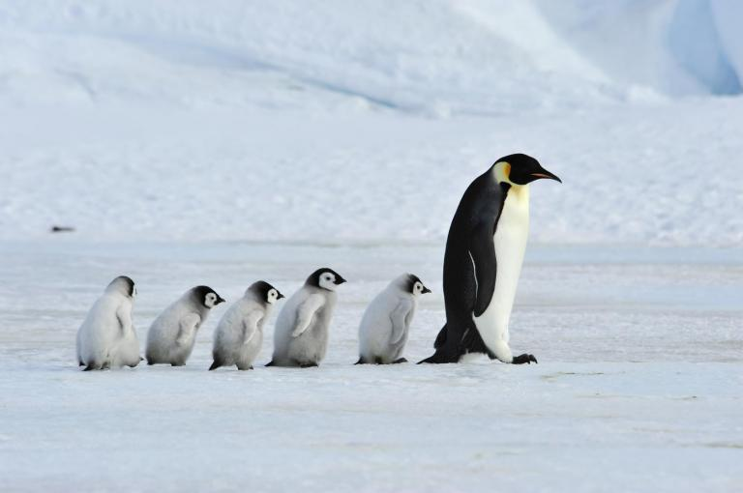

Forever young property
Exponential distribution
Radioactive decay
=
AGING
<
>
REJUVENATION
Mediocristan
Extremistan

Slide 8
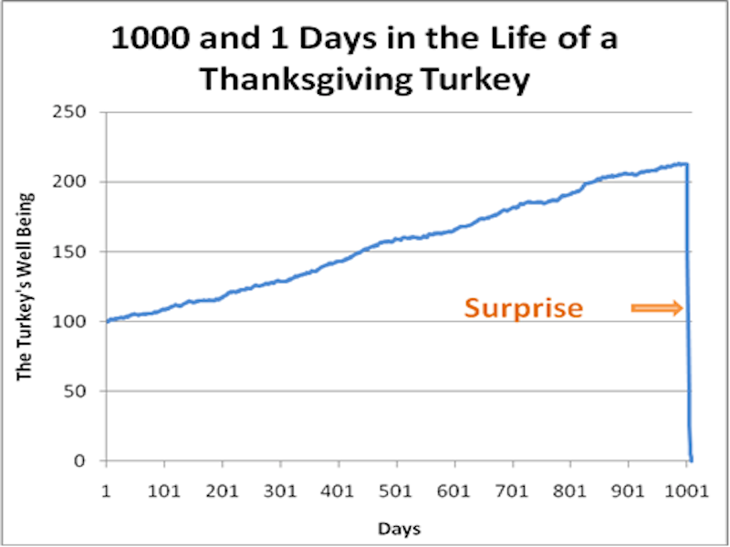
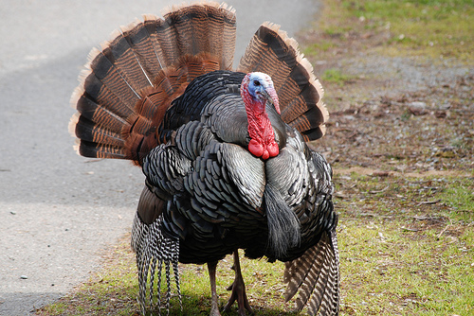
DON’T be a turkey
Problem: we think that we live in Mediocristan, but actually not.

Slide 9
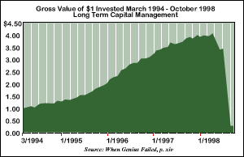
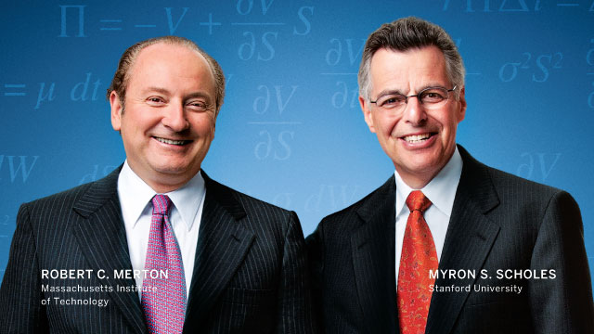
don’t be a nobel prize winner Turkey
1997: Nobel Prize
1998: LTCM Blow Up

Slide 10
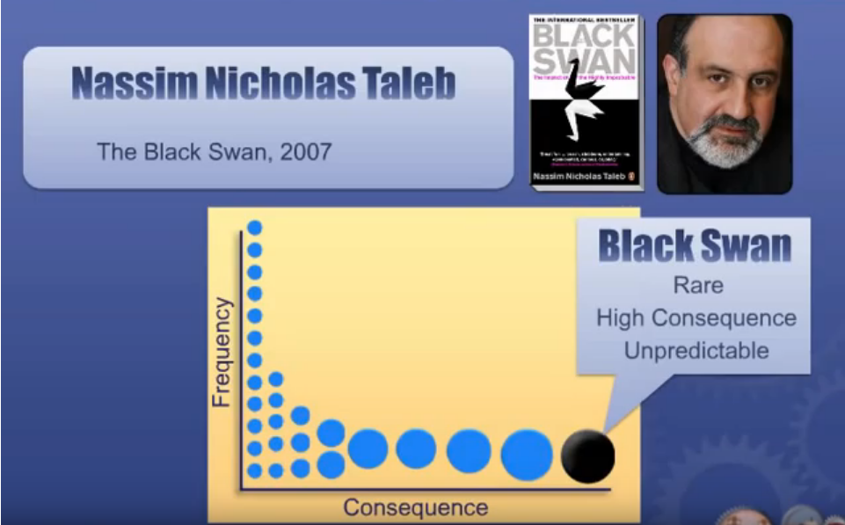
black swan swims in

Slide 11
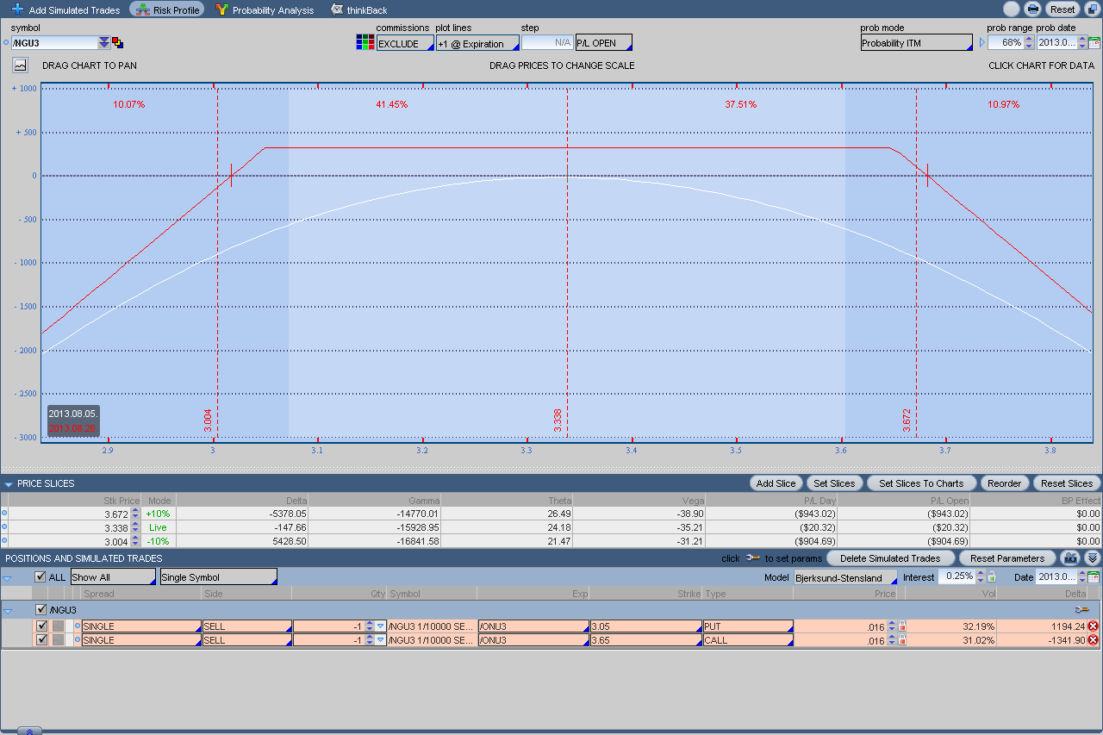
nonlinear exposure => fragility
https://www.opcioguru.com/blog/opcios-kereskedes/1265-95-ot-buktam-tanulhatsz-belole

Slide 12
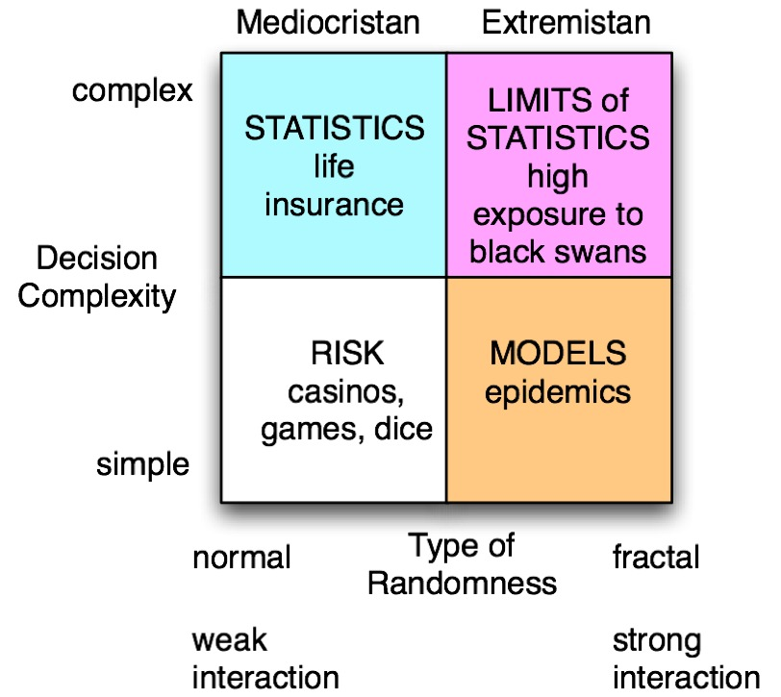
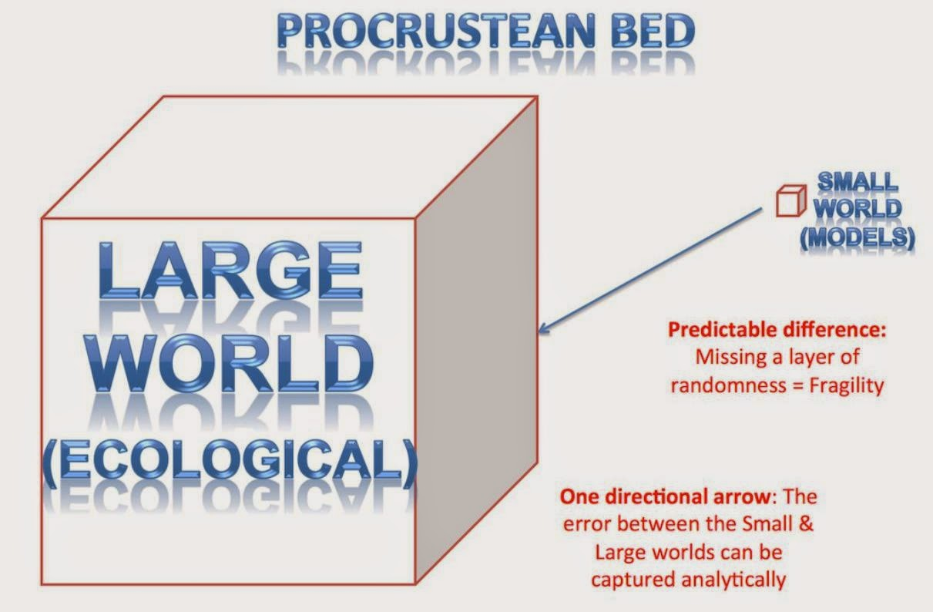
where black swans nestle

Slide 13
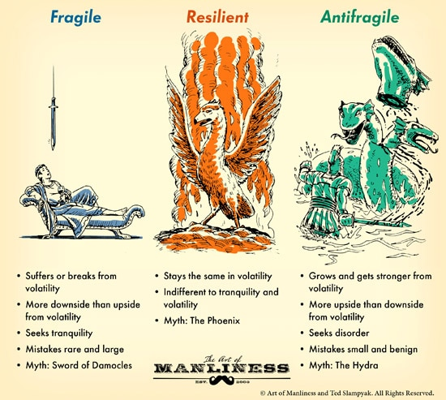
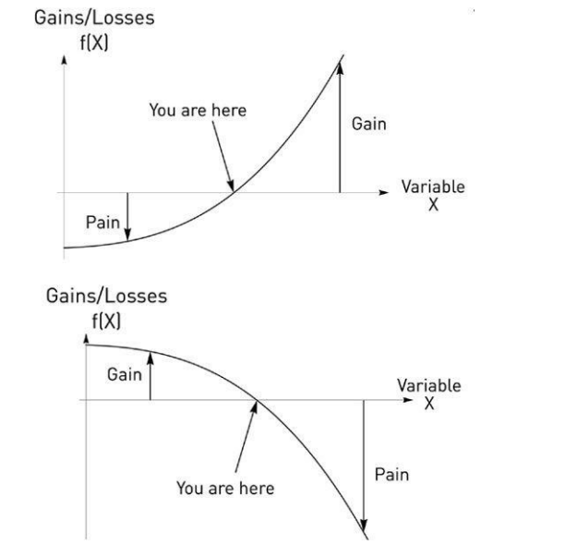
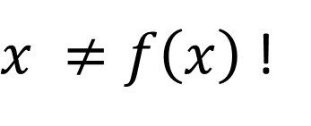

solution: be antifragile
$x ≠f\left(x\right)$ !

Slide 14
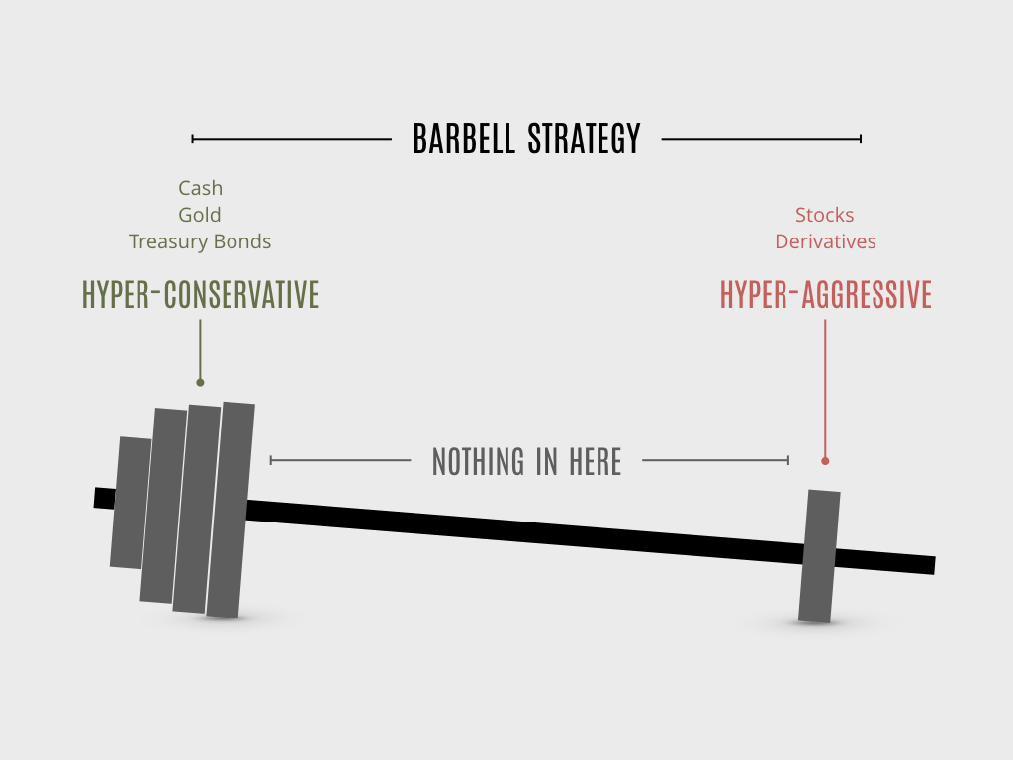
investment strategy

Slide 15




Taleb books

Slide 16



Other recommended readings

Slide 17

questions?
http://www.blackswanman.com/

